Slide 1
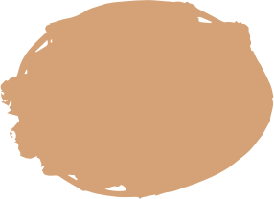

CS114.O11.KHCL
Face Mask Detection
Trần Nhật Đức - 21521968
Hồ Trung Tín - 21521536
Phạm Đức Toàn - 21521550

Slide 2
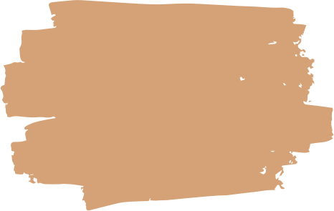
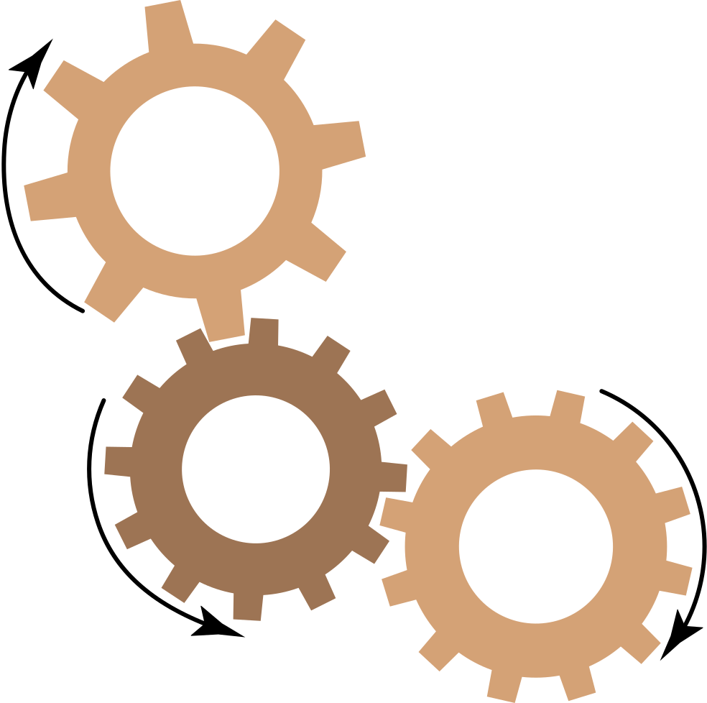
01
LIST OF CONTENT
PRESENTATION
INTRODUCTION TO
FACE MASK DETECTION
02
FACE MASK DETECTION DATASET
03
YOLO v5 & SVM
04
DEMONSTRATION

Slide 3


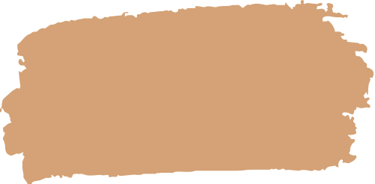
INTRODUCTION TO FACE MASK DETECTION

Slide 4
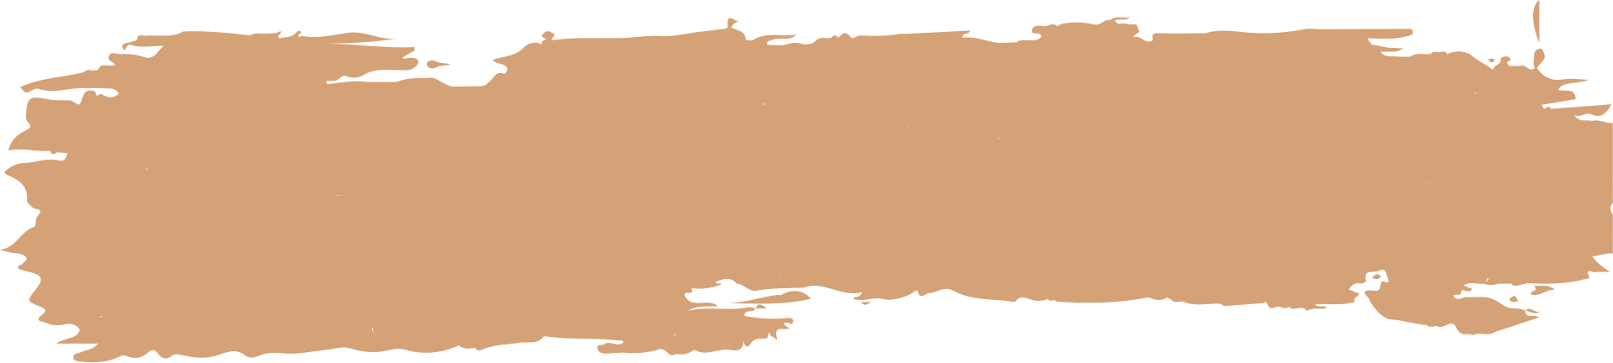



Face mask detection is a computer vision technology that aims to identify whether an individual is wearing a face mask correctly, incorrectly, or not wearing a mask at all.
Input: Images or video frames which contain human faces that need to be analyzed for the presence and proper usage of face masks.
Output: Bounding boxes that tightly enclose the detected human faces in the input images or video frames. Each bounding boxes has a class label that indicate the mask-wearing status of the detected faces: "Mask," "Wearing Improperly," or "No Mask."

Slide 5


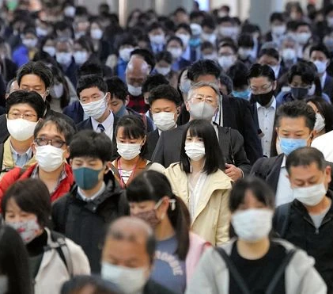
APPLICATIONS OF FACE MASK DETECTION:
The COVID-19 pandemic in the past highlighted the importance of wearing face masks as a crucial preventive measure.
Face mask detection models can be used in healthcare settings to ensure that patients, visitors, and staff are complying with mask-wearing protocols. This can be crucial in preventing the spread of infectious diseases within hospitals and clinics.
Implementing face mask detection in workplaces can contribute to maintaining a safe environment. This is particularly relevant in industries where maintaining physical distancing might be challenging, such as manufacturing plants, construction sites, or office spaces.

Slide 6
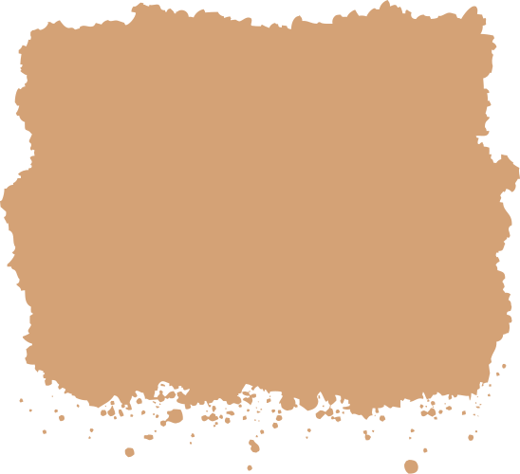

02. DATASET

Slide 7
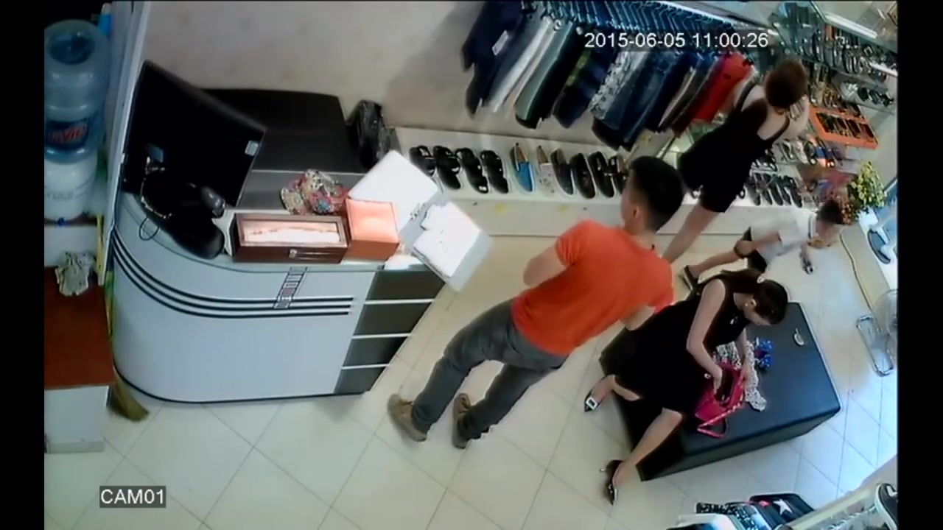
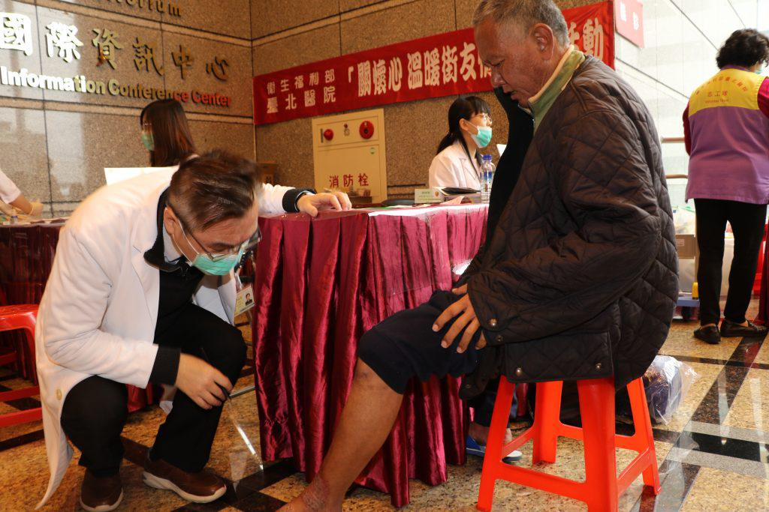
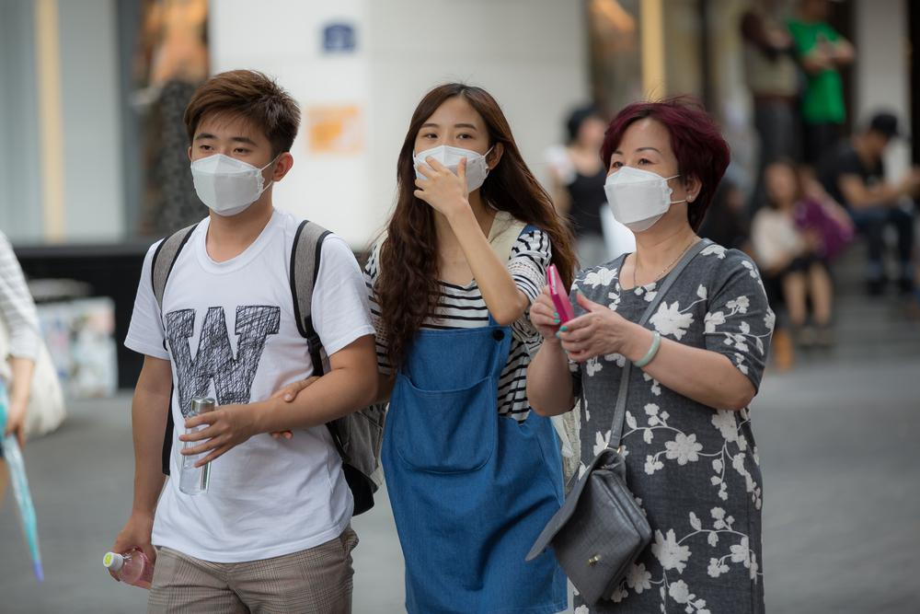
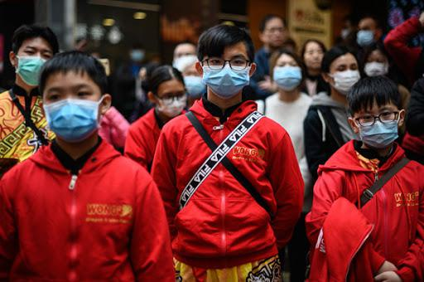
DATASET: a custom dataset containing 874 images belonging to 3 classes, as well as their bounding boxes.
The classes are:
Mask;
No mask;
Mask worn incorrectly.

Slide 8
03. YOLOv5

Slide 9

YOLOv5:
“YOLO”, refering to “You Only Look Once”, is a family of object detection models introduced by Joseph Redmon with a 2016 publication “You Only Look Once: Unified, Real-Time Object Detection”.
Since then, several newer versions have been released, of which, the first three were released by Joseph Redmon. On June 29, Glenn Jocher released the latest version YOLOv5, claiming significant improvements with respect to its predecessor.
YOLOv5 is very fast, performant and easy to use.

Slide 10
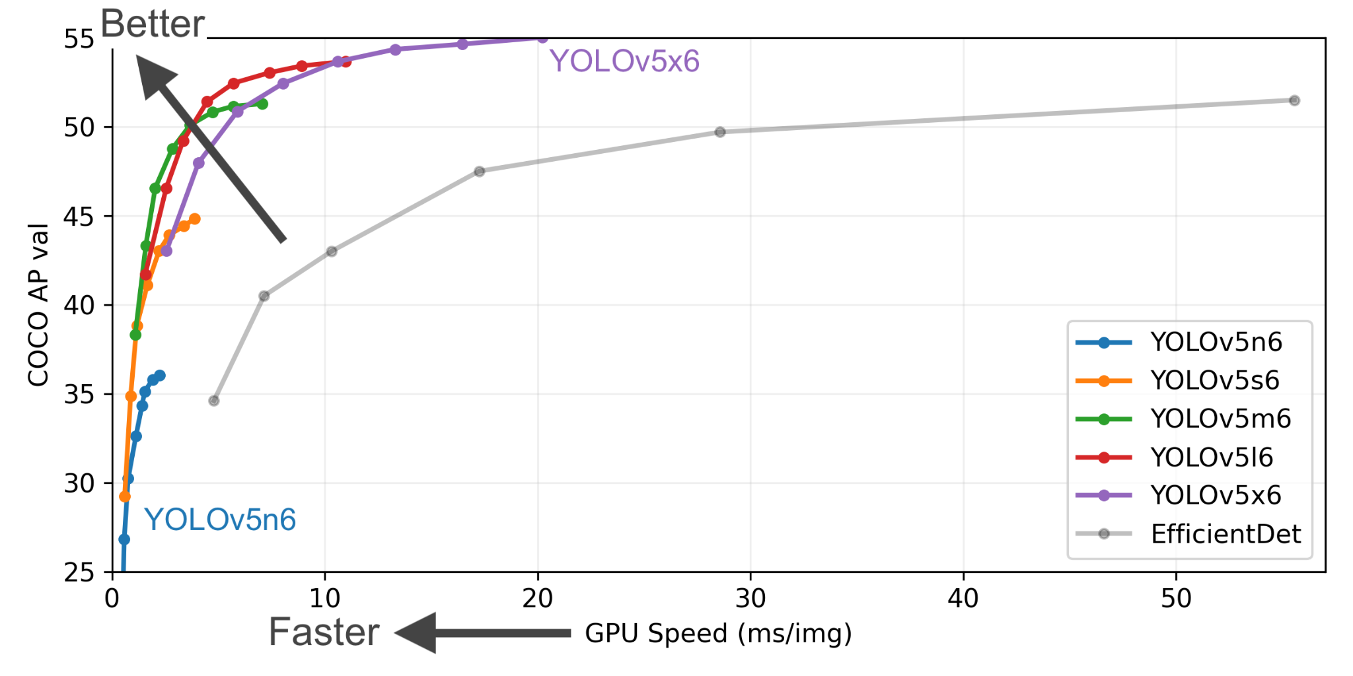
YOLOv5:
“YOLO”, refering to “You Only Look Once”, is a family of object detection models introduced by Joseph Redmon with a 2016 publication “You Only Look Once: Unified, Real-Time Object Detection”.
Since then, several newer versions have been released, of which, the first three were released by Joseph Redmon. On June 29, Glenn Jocher released the latest version YOLOv5, claiming significant improvements with respect to its predecessor.
YOLOv5 is very fast, performant and easy to use.

Slide 11
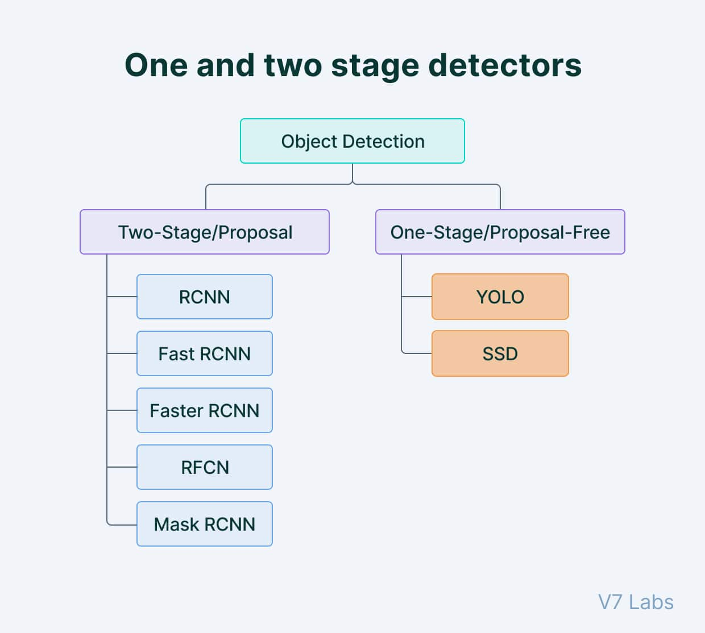
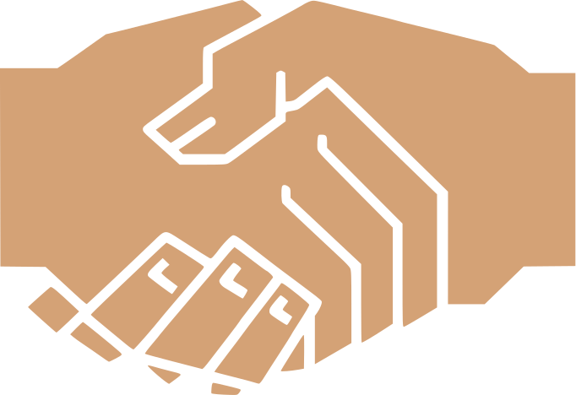

YOLO is a single-shot detector
Object detection algorithms are broadly classified into two categories based on how many times the same input image is passed through a network.
Single-shot object detection uses a single pass of the input image to make predictions about the presence and location of objects in the image. It processes an entire image in a single pass, making them computationally efficient.

Slide 12
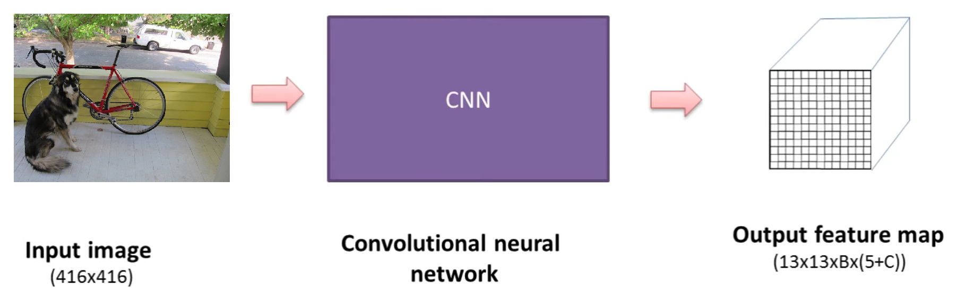
How YOLO works:
YOLO takes the input image and passes it through a CNN, generating a feature map of size S×S, called a grid. YOLO performs object detection at each cell within the S×S grid.

Slide 13
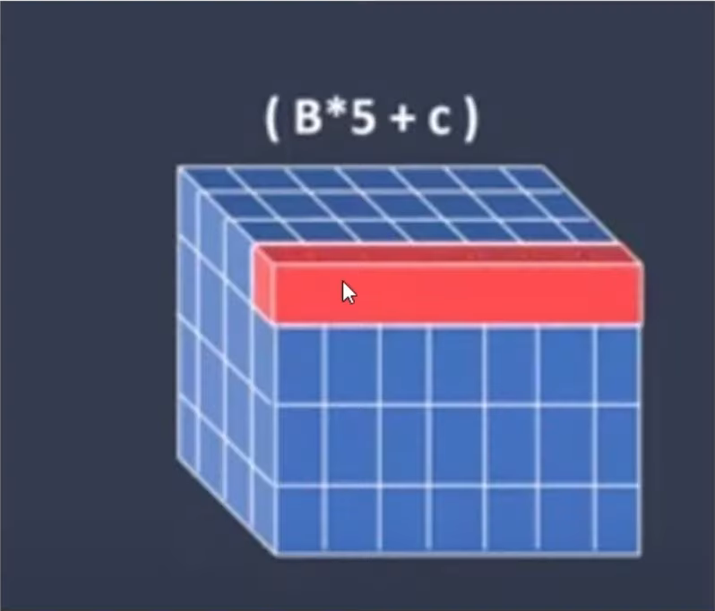
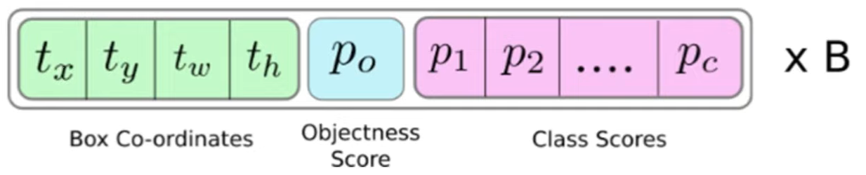
How YOLO works:
In each cell, YOLO predicts B bounding boxes and probabilities for C classes. Each bounding box contains 5 pieces of information: the center coordinates of the bounding box (x, y), the width and height of the bounding box (w, h), and the Objectness score. The Objectness score is used to determine whether an object exists within that bounding box or not.

Slide 14
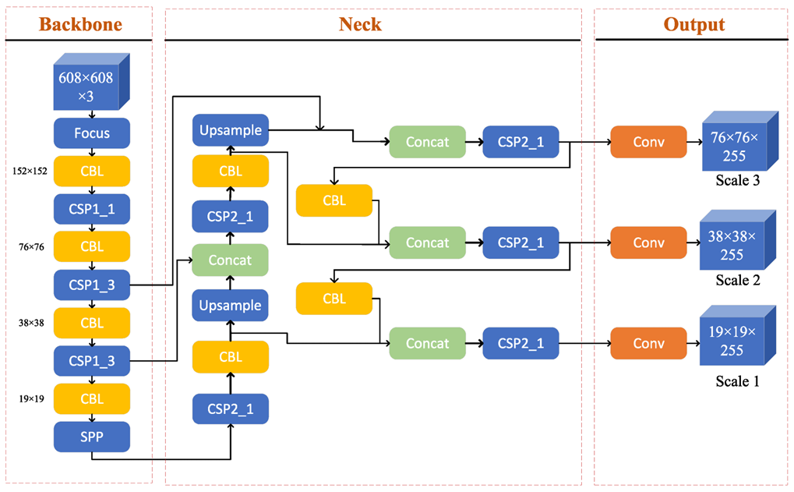
YOLOv5 architecture:

Slide 15
04. DEMONSTRATION

Slide 16



REFERENCES:
https://towardsdatascience.com/face-mask-detection-using-yolov5-3734ca0d60d8
https://github.com/iAmEthanMai/mask-detection-dataset
https://medium.com/analytics-vidhya/covid-19-face-mask-detection-using-yolov5-8687e5942c81
https://github.com/spacewalk01/yolov5-face-mask-detection
https://www.v7labs.com/blog/yolo-object-detection#:~:text=YOLO%20v5%20uses%20a%20new,clusters%20as%20the%20anchor%20boxes.
https://blog.roboflow.com/yolov5-improvements-and-evaluation/
https://iq.opengenus.org/yolov5/
https://viblo.asia/p/tong-hop-kien-thuc-tu-yolov1-den-yolov5-phan-1-naQZRRj0Zvx

Slide 17
THANK YOU
Do you have any questions?

